Slide 1
CSC-350 Topics in Computer Science Spring 2024
Dr. Farhan Aadil
farhan.aadil@cuiatk.edu.pk
DrAadil.com
Please turn OFF your Mobile Phones!

Slide 2


DevOps
Automation Everything You
Need to Know
Dr. Farhan Aadil
CS Department, CUI Attock

Slide 3
Docker Commands
Docker version
Docker search
Docker pull
Docker run
Docker ps
Docker stop
Docker restart
Docker kill
Docker exec
Docker login
Docker commit
Docker push
Docker network
Docker history
Docker rmi
Docker ps -a
Docker copy
Docker logs
Docker volume
Docker logout
Attaching to running containers
You can attach your shell to the terminal of a running container with the docker exec command
Renaming a running container
docker rename [OLD_NAME] [NEW_NAME]
Searching the Docker Registry
docker search --filter is-official=true --filter stars=500 mysql
Pushing image to docker registry
docker push draadil/spring24:tagname

Slide 4
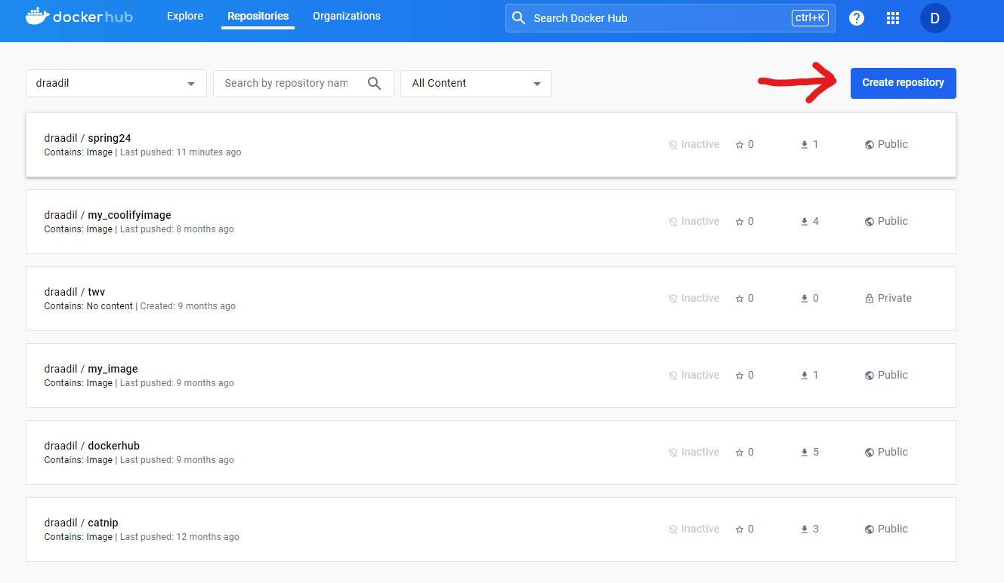
Creating First Repository in Docker Hub Using GUI

Slide 5
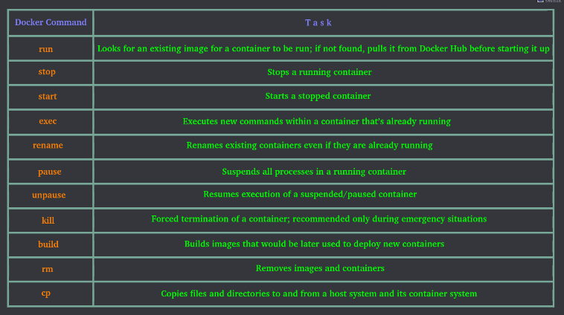

Slide 6
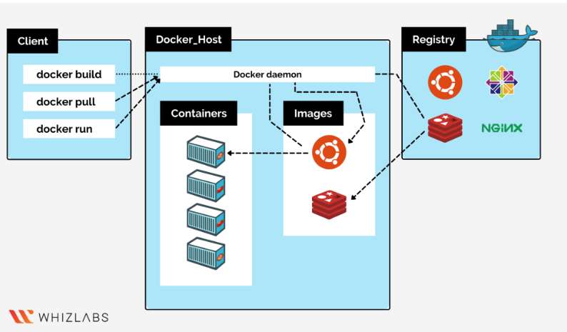
Docker on Windows

Slide 7
Docker Images
What is Docker Image?
Difference between Docker Image VS Docker Container
Docker Images source
Structure Of Docker Image
Types of Images
Source of Image (Dockerfile)

Slide 8
What is Docker Image?
Uses of Docker Images
Docker images are built using the Dockerfile which consists of a set of instructions that are required to containerize an application.
The docker image includes the following to run a piece of software. A docker image is a platform-independent image that can be built in the Windows environment, and it can be pushed to the docker hub and pulled by others with different OS environments like Linux.
Application Code.
Runtime.
Libraries
Environmental tools.
Docker image is very light in weight so can be portable to different platforms very easily.
We can easily and effectively run the containers with the aid of docker images.
All the code, configuration settings, environmental variables, libraries, and runtime are included in a Docker image.
Docker images are platform-independent.
Layers are the building blocks of an image.
When using the build command, the user has the option of completely starting from scratch or using an existing image for the first layer.

Slide 9
Difference between Docker Image VS Docker Container
Docker image | Docker container
The Docker image is the Docker container’s source code. | The Docker container is the instance of the Docker image.
Dockerfile is a prerequisite to Docker Image. | Docker Image is a pre-requisite to Docker Container.
Docker images can be shared between users with the help of the Docker Registry. | Docker containers can’t be shared between the users.
To make changes in the docker image we need to make changes in Dockerfile. | We can directly interact with the container and can make the changes required.

Slide 10
Docker Images source
To get a new Docker image you can either get it from a registry (such as the Docker Hub) or create your own.
There are tens of thousands of images available on Docker Hub.
You can also search for images directly from the command line using docker search.

Slide 11
Structure Of Docker Image
An important distinction to be aware of when it comes to images is the difference between base and child images.
The layers of software that make up a Docker image make it easier to configure the dependencies needed to execute the container.
Base images The base image will be the starting point for the majority of Dockerfiles, and it can be made from scratch. These are images that have no parent image, usually images with an OS like ubuntu, busybox or Debian etc.
Child images are images that build on base images and add additional functionality.

Slide 12
Types of Images
Then there are official and user images, which can be both base and child images.
Official images are images that are officially maintained and supported by the folks at Docker. These are typically one word long. In the list of images above, the python, ubuntu, busybox and hello-world images are official images.
User images are images created and shared by users like you and me. They build on base images and add additional functionality. Typically, these are formatted as user/image-name.

Slide 13
Dockerfile
A Dockerfile is a simple text file that contains a list of commands that the Docker client calls while creating an image.
It's a simple way to automate the image creation process. The best part is that the commands you write in a Dockerfile are almost identical to their equivalent Linux commands. This means you don't really have to learn new syntax to create your own dockerfiles.

Slide 14
Dockerfile
The application directory does contain a Dockerfile but since we're doing this for the first time, we'll create one from scratch.
To start, create a new blank file in our favorite text-editor and save it in the same folder as the flask app by the name of Dockerfile.

Slide 15
Our First Image
Let’s do it …..
https://www.tutorialspoint.com/docker/building_docker_files.htm
https://docs.docker.com/build/building/packaging/

Slide 16

Docker images and Containers
Docker containers are instances of Docker images, whether running or stopped. In fact, the major difference between Docker containers and images is that containers have a writable layer.
When you create a Docker container, you’re adding a writable layer on top of the Docker image. You can run many Docker containers from the same Docker image. You can see a Docker container as an instance of a Docker image
https://stackify.com/docker-build-a-beginners-guide-to-building-docker-images/
https://codefresh.io/blog/build-docker-image-dockerfiles/

